Slide 1

Let’s start with Allah Yaar
Bs in Computer Science

Slide 2
Value Models
Value Models
Value models are frameworks that describe how organizations create, deliver, and capture value through their activities, resources, and interactions with stakeholders.

Slide 3
Value Models
Purpose of Value Models:
To understand how value flows within an organization.
To identify areas for innovation and improvement.
To align technology and business processes for better outcomes.

Slide 4
Value Models
Examples:
E-commerce platforms (Amazon): Create value by streamlining purchasing processes and offering a wide selection of products.
Cloud services (AWS): Deliver value through scalable and cost-effective computing solutions.

Slide 5
Value Chain
Value Chain
The value chain is a model introduced by Michael Porter that identifies the primary and support activities in an organization that add value to products or services at each stage.

Slide 6
Value Chain
Components of the Value Chain:
Primary Activities: Activities directly involved in producing and delivering products/services.
Inbound Logistics: Managing inputs like raw materials.
Example: Receiving and storing inventory in a manufacturing unit.
Operations: Transforming inputs into finished goods.
Example: Assembling a smartphone.

Slide 7
Value Chain
Outbound Logistics: Distributing the finished product to customers.
Example: Shipping orders from Amazon warehouses.
Marketing and Sales: Promoting and selling the product.
Example: Running targeted online ads for a new product launch.
Service: Post-sale activities to maintain customer satisfaction.
Example: Offering 24/7 technical support.

Slide 8
Value Chain
Support Activities: Activities that assist primary activities in creating value.
Firm Infrastructure: Organizational structure and management.
Human Resource Management: Recruitment, training, and employee management.

Slide 9
Value Chain
Technology Development: Implementing and managing IT systems.
Example: Automating warehouse management using RFID technology.
Procurement: Acquiring inputs required for production.
Example: Sourcing raw materials from suppliers

Slide 10
Value Chain
Objective:
To identify areas where ICT can optimize processes and add value.
Example: Using ERP (Enterprise Resource Planning) systems to integrate activities across the value chain.

Slide 11
Value Shop
Value Shop
The value shop model focuses on problem-solving and knowledge-based activities where value is created by addressing specific customer needs.

Slide 12
Value Shop
Key Characteristics:
Problem identification and analysis.
Development of solutions tailored to unique requirements.
Delivery of customized services.

Slide 13
Value Shop
Steps in Value Shop:
Problem Definition: Understanding the client’s needs.
Example: A company hiring an IT consultancy firm to secure its network.
Solution Development: Proposing and designing solutions.
Example: Designing a cybersecurity strategy for the company.

Slide 14
Value Shop
Solution Delivery: Implementing the solution.
Example: Installing firewall and intrusion detection systems.
Evaluation and Feedback: Reviewing the solution's effectiveness and making improvements.
Example: Monitoring network security and updating protocols.

Slide 15
Value Shop
Examples:
Consulting Firms: Provide expertise to solve organizational challenges.
Healthcare Services: Diagnose and treat patient-specific conditions.

Slide 16
Value Network
Value Network
The value network model emphasizes collaboration and interconnectivity among participants to create value. It relies heavily on ICT to enable communication, resource sharing, and partnerships.

Slide 17
Value Network
Key Characteristics:
Focus on relationships and interactions rather than linear processes.
Value is created through collaboration and exchange.
Participants include businesses, customers, and other stakeholders.

Slide 18
Value Network
Types of Value in a Network:
Tangible Value: Direct exchange of goods or services.
Example: A bank providing online payment services to a retail company.
Intangible Value: Sharing knowledge, reputation, or trust.
Example: Collaborative research in universities.

Slide 19
Value Network
Examples of Value Networks:
Social Media Platforms: Facebook creates value by connecting users and advertisers.
Logistics Networks: DHL uses ICT to coordinate with suppliers, customers, and partners for efficient delivery.

Slide 20
Value Network
Role of ICT in Value Networks:
Facilitates communication through real-time platforms.
Enhances data sharing and decision-making with cloud services.
Optimizes resource allocation with IoT and AI technologies.

Slide 21
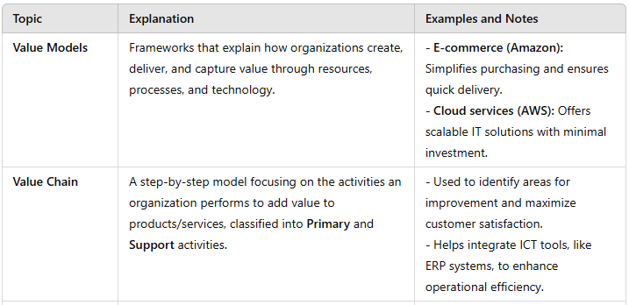
Summary Table

Slide 22
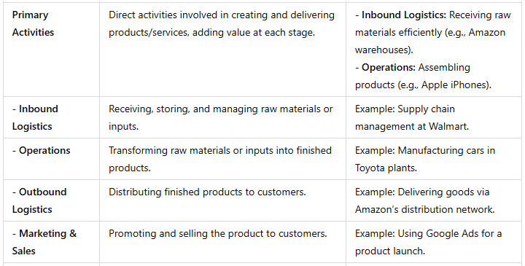
Summary Table

Slide 23
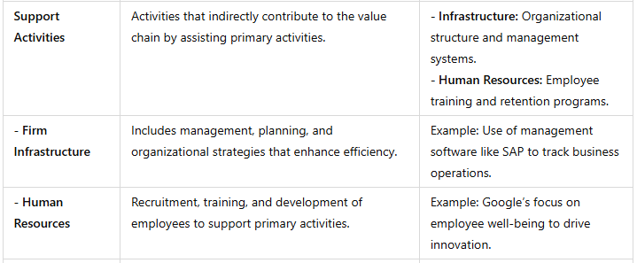
Summary Table

Slide 24
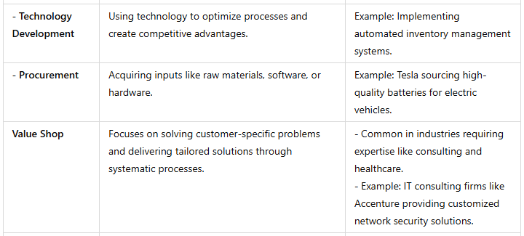
Summary Table

Slide 25
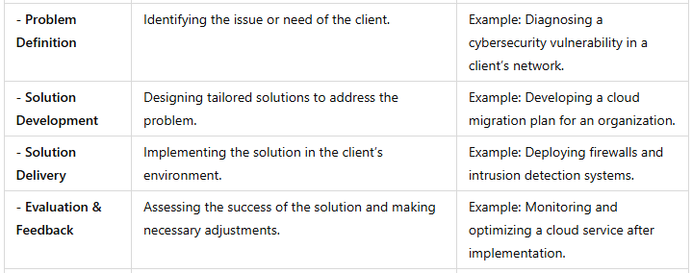
Summary Table

Slide 26
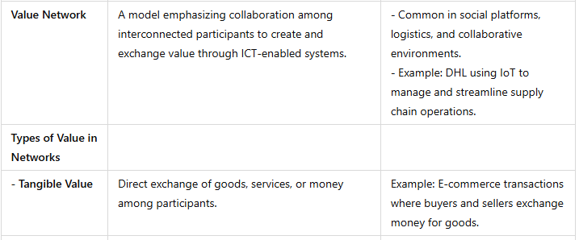
Summary Table

Slide 27
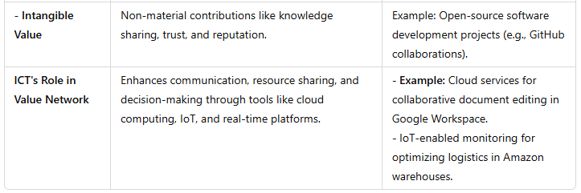
Summary Table

